Slide 1
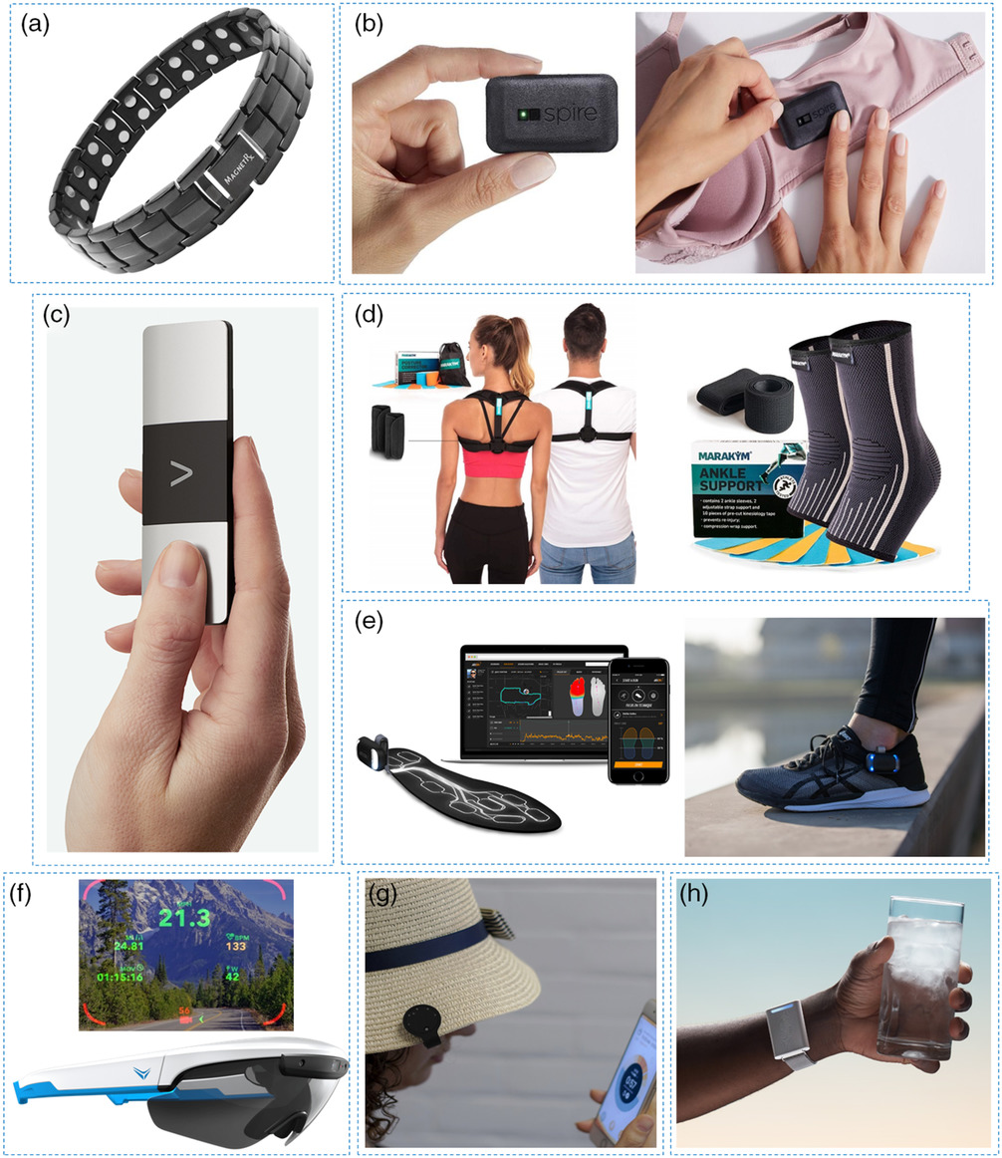
Trends in Workplace Wearable Technologies and Connected‐Worker Solutions for Next‐Generation Occupational Safety, Health, and Productivity
Figure 4: Examples of wearables for occupational health monitoring. a) The MagnetRX Ultra Strength Magnetic Therapy Bracelet uses magnetic field stimulation to reduce pain and inflammation. b) The Spire Health Tag tracks the breathing, sleep, and stress patterns with advice on stress reactivity. c) Omron's KardiaMobile 6L EKG detects heart rhythm, atrial fibrillation, bradycardia, and tachycardia. d) The Marakym Posture Corrector ensures stability and alignment, while the Marakym Ankle Support uses compression to prevent injury or facilitate faster recovery from injury. e) Arion Smart Insoles and Footpods monitor the cadence, posture, and balance with real-time feedback on corrective measures. f) Everysight Raptor Smart Glasses assist with navigation displays and outdoor awareness. g) The QSun UV Exposure Tracker monitors outdoor sun exposure and vitamin D levels with personalized recommendations. h) The Embr Labs Wave Bracelet generates warm or cooling waveforms on the wrist to alleviate thermal discomfort.
Advanced Intelligent Systems, Volume: 4, Issue: 1, First published: 23 September 2021, DOI: (10.1002/aisy.202100099)
Notes:
Examples of wearables for occupational health monitoring. a) The MagnetRX Ultra Strength Magnetic Therapy Bracelet uses magnetic field stimulation to reduce pain and inflammation. b) The Spire Health Tag tracks the breathing, sleep, and stress patterns with advice on stress reactivity. c) Omron's KardiaMobile 6L EKG detects heart rhythm, atrial fibrillation, bradycardia, and tachycardia. d) The Marakym Posture Corrector ensures stability and alignment, while the Marakym Ankle Support uses compression to prevent injury or facilitate faster recovery from injury. e) Arion Smart Insoles and Footpods monitor the cadence, posture, and balance with real‐time feedback on corrective measures. f) Everysight Raptor Smart Glasses assist with navigation displays and outdoor awareness. g) The QSun UV Exposure Tracker monitors outdoor sun exposure and vitamin D levels with personalized recommendations. h) The Embr Labs Wave Bracelet generates warm or cooling waveforms on the wrist to alleviate thermal discomfort. a) Reproduced with permission.[150] Copyright 2021, MagnetRX; b) Reproduced with permission.[177] Copyright 2021, Spire Health; c) Reproduced with permission.[186] Copyright 2021, Omron; d) Reproduced with permission.[232] Copyright 2021, Marakym; e) Reproduced with permission.[67] Copyright 2021, Arion; f) Reproduced with permission.[106] Copyright 2021, Everysight; g) Reproduced with permission.[196] Copyright 2021, QSun; and h) Reproduced with permission.[197] Copyright 2021, Embr Labs.
IF THIS IMAGE HAS BEEN PROVIDED BY OR IS OWNED BY A THIRD PARTY, AS INDICATED IN THE CAPTION LINE, THEN FURTHER PERMISSION MAY BE NEEDED BEFORE ANY FURTHER USE. PLEASE CONTACT WILEY'S PERMISSIONS DEPARTMENT ON PERMISSIONS@WILEY.COM OR USE THE RIGHTSLINK SERVICE BY CLICKING ON THE 'REQUEST PERMISSIONS' LINK ACCOMPANYING THIS ARTICLE. WILEY OR AUTHOR OWNED IMAGES MAY BE USED FOR NON-COMMERCIAL PURPOSES, SUBJECT TO PROPER CITATION OF THE ARTICLE, AUTHOR, AND PUBLISHER.

